Slide 1
基於時序金字塔之第一人稱影像行為辨識 Activity Recognition in First-Person Camera View Based on Temporal Pyramid
Speaker: Hsaun-Ming Liu
Advisor: Ming Ouhyoung, Ph.D

Slide 2
Outline
Introduction
Related work
System Overview
Method
Experiments & Results
Demo
Conclusion

Slide 3
Introduction

Slide 4
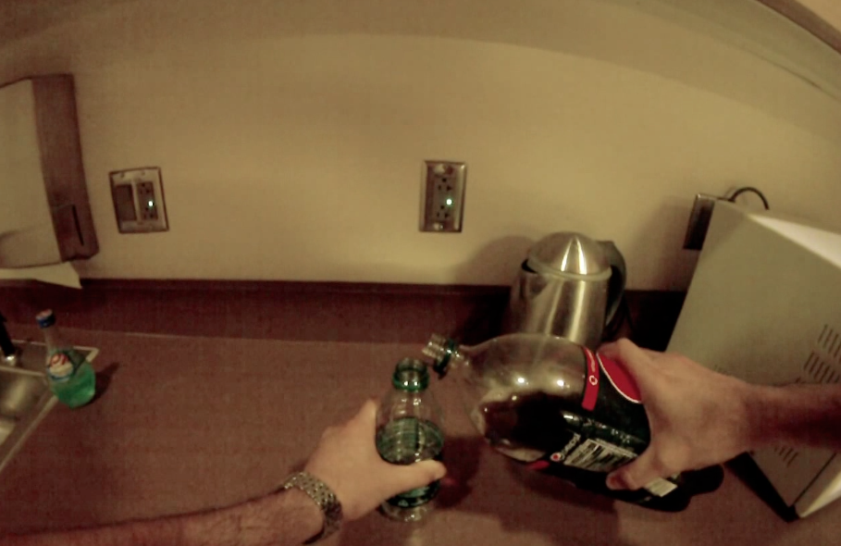

Problem Definition
First-Person-View Videos
Ongoing Activity
Notes:
當我們擁有第一人稱影片,如何去辨識畫面中主角正在從事的行為

Slide 5
Problem Definition
First-Person-View Videos
Activity of Daily Life
Eating,
Drinking,
Laundry,
etc.
Notes:
在碩論中先限縮問題範圍

Slide 6
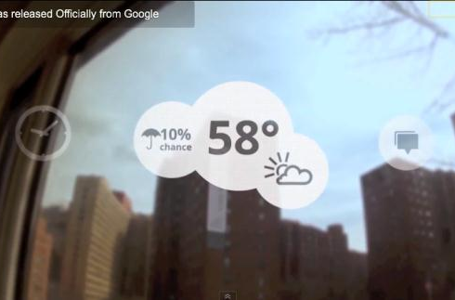
Motivation
Multimodal Context Aware Service

Slide 7
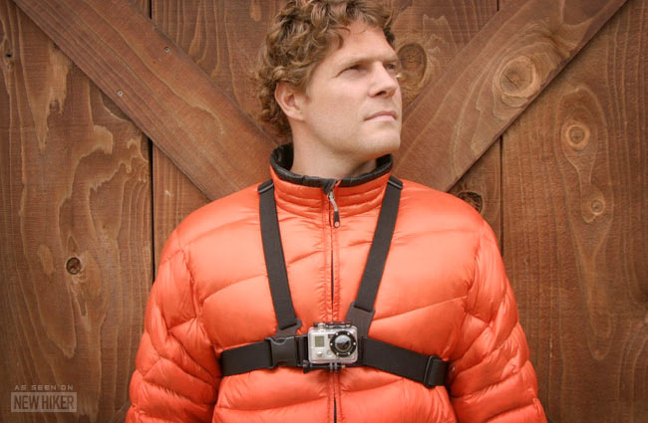

The Time has Come
Device : GoPro camera, Google Glass

Slide 8
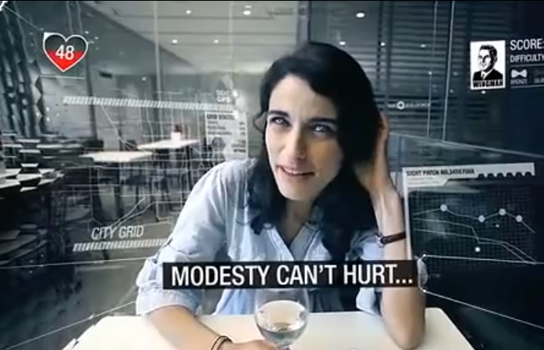
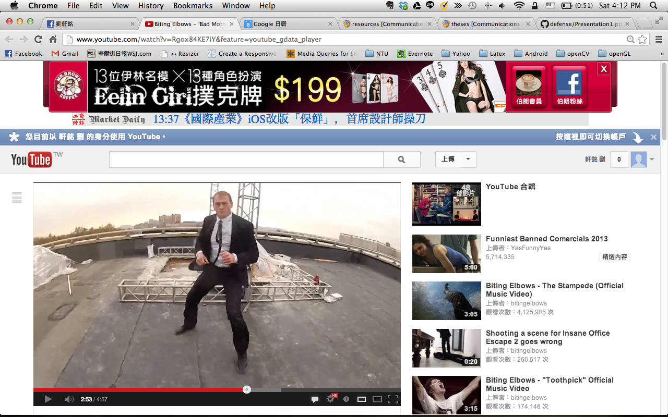
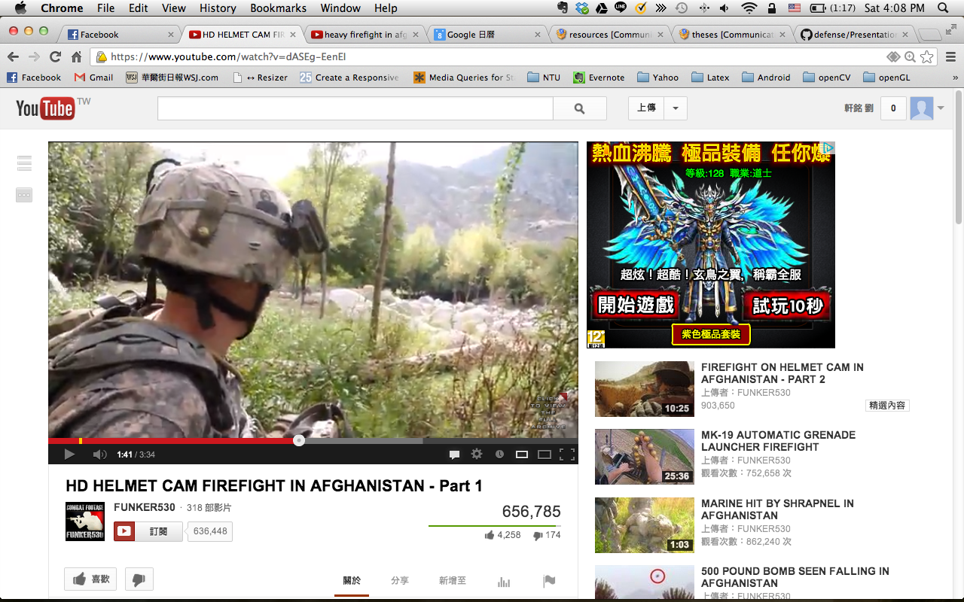
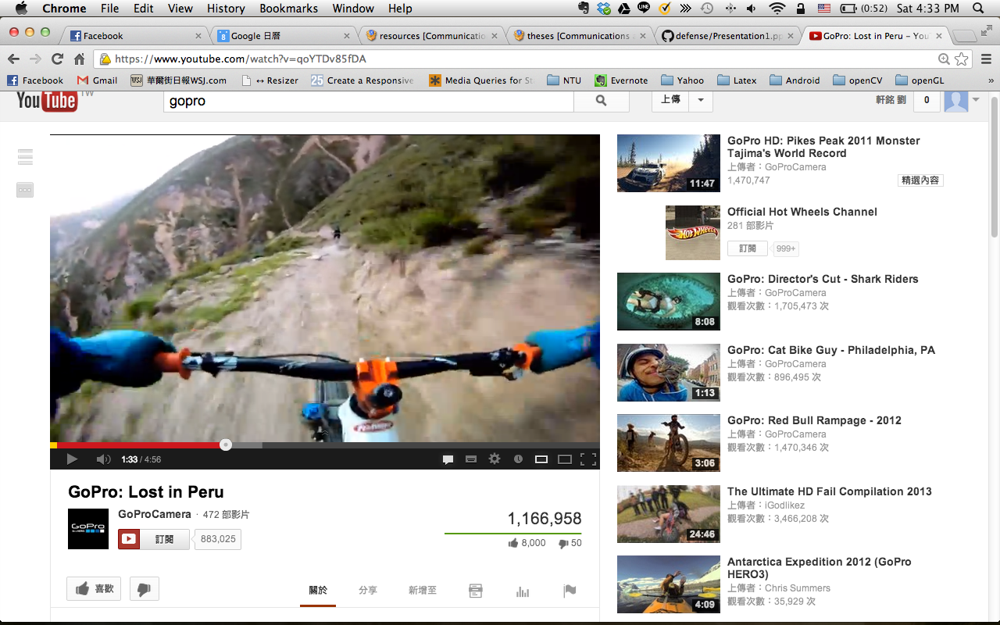
The Time has Come
Contents

Slide 9
The Problem
Properties of Activities of Daily Life
Good Part | Bad Part
Sequential | Interleaved/Co-occurrence
 | variation in duration

Slide 10
The Problem
Properties of Activities of Daily Life
Good Part | Bad Part
Sequential | Interleaved/Co-occurrence
 | variation in duration
Temporal Pyramid,
Sequence Finding
Conditional Random Fields

Slide 11
Related Work

Slide 12
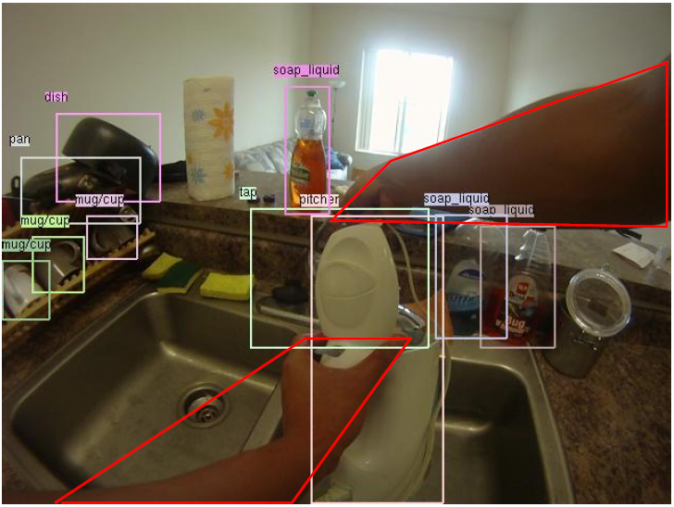
Related Work
Conditional Random Fields for Activity Recognition [Vail et al., 07]
Detecting Activities of Daily Living in First-person Camera Views [Pirsiavash et al., 12]
Notes:
Conditional Random Fields for Activity Recognition:
In cases where features depend on observations from many time steps, we confirm that CRFs are robust against any degradation in performance
在機器人領域” In the robot tag domain, we wish to identify which robot is the seeker at each time step of the simulation”, features: Raw Positions, Velocities,

Slide 13
System Overview

Slide 14
System Overview
detector
feature vector
(segment)
new frame
. detector
feature vector
obj. detector
similar with the latest segment?
new features
no
features
new features
features
features
features
new features
yes
discard
Merge and Build
new features
features
new features
Laundry stage 1
features
features
new features
Laundry
Stage 2
features
Refresh
Inference

Slide 15
Visual Phrase Object Feature
detector
feature vector
(segment)
new frame
. detector
feature vector
obj. detector
similar with the latest segment?
new features
no
features
new features
features
features
features
new features
yes
discard
Merge and Build
new features
features
new features
Laundry stage 1
features
features
new features
Laundry
Stage 2
features
Refresh
Inference

Slide 16
Temporal Pyramid
detector
feature vector
(segment)
new frame
. detector
feature vector
obj. detector
similar with the latest segment?
new features
no
features
new features
features
features
features
new features
yes
discard
Merge and Build
new features
features
new features
Laundry stage 1
features
features
new features
Laundry
Stage 2
features
Refresh
Inference

Slide 17
Online Inference
detector
feature vector
(segment)
new frame
. detector
feature vector
obj. detector
similar with the latest segment?
new features
no
features
new features
features
features
features
new features
yes
discard
Merge and Build
new features
features
new features
Laundry stage 1
features
features
new features
Laundry
Stage 2
features
Refresh
Inference

Slide 18
Method

Slide 19
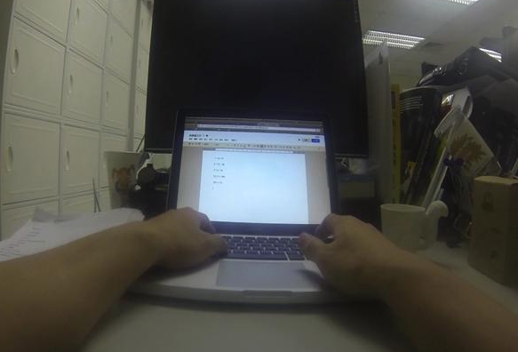
Visual Phrase Object Feature
Active Laptop
Passive Cup

Slide 20
Visual Phrase Object Feature
It’s all about objects
Detecting Activities of Daily Living in First-person
Camera Views [Pirsiavash et al., 12]
Activity Recognition in the Home Using Simple
and Ubiquitous Sensors [Tapia et al., 04]
An emerging pattern based approach to activity
recognition [Gu et al., 09]
Improvement in object detection
Recognition Using Visual Phrases [Sadeghi et al,. 11]

Slide 21
Visual Phrase Object Feature
denote indexes of an input sequence with n frames
denote indexes of m objects
Feature vector(frame):
Where f_{i} contains m labels such that
if object o is detected in frame I, otherwise

Slide 22
Visual Phrase Object Feature
denote indexes of an input sequence with n frames
denote indexes of m objects
Feature vector(frames):
Where f_{i} contains m labels such that
if object o is detected in frame I, otherwise
Active Laptop
Passive
Cup

Slide 23
Temporal Pyramid
Let T represent a temporal pyramid
T_{l,k} is the k _{th} time segment on level l of the pyramid
T_{2,0}
T_{1,0}
T_{1,1}
T_{0,0}
T_{0,1}
T_{0,2}
T_{0,3}

Slide 24
Temporal Pyramid
Why Temporal Pyramid?
Multi-resolution in Time Domain
Correction of Object Detection
Alternative of Hierarchical Methods

Slide 25
Temporal Pyramid
Why Temporal Pyramid?
Multi-resolution in Time Domain
T_{2,0}
T_{1,0}
T_{1,1}
T_{0,0}
T_{0,1}
T_{0,2}
T_{0,3}
time

Slide 26
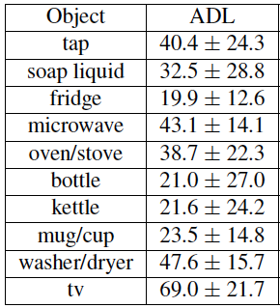
Temporal Pyramid
Why Temporal Pyramid?
Correction of Object Detection
Precision & std. deviation of the
Object detection in the dataset [Pirsiavash et al., 12]

Slide 27
Temporal Pyramid
Why Temporal Pyramid?
Alternative of Hierarchical Methods
(留到future work? No, 加在這裡)

Slide 28
Sequence Labeling
I denote the video frames
L denote the set of possible activities
Linear-chain Conditional Random Fields

Slide 29
Sequence Labeling
Linear-chain Conditional Random Fields
basket
clothes
detergent
washer
basket
clothes
detergent
washer
Laundry Stage 1
Laundry Stage 2
Activities of frames

Slide 30
Sequence Labeling
Linear-chain Conditional Random Fields
basket
clothes
detergent
washer
basket
clothes
detergent
washer
Laundry Stage 1
Laundry Stage 2
Activities of segments

Slide 31
Online Inferencing
Laundry stage 1
Laundry
Stage 2
prediction
prediction
prediction
prediction
sliding window

Slide 32
A Laundry Example
S_{0,0}
B_{0,0}
P = 0.6, a_{0,0 =} Clothing

Slide 33
A Laundry Example
S_{0,0}
S_{0,1}
H
B_{0,1}
P = 0.4, a_{0,1} = clothing
a_{0,0} | P = 0.02, a_{0,1} = something else
B_{0,0}
P = 0.6, a_{0,0 =} Clothing
Path H

Slide 34
A Laundry Example
S_{0,0}
B_{1,0}
P=0.6, a_{1,0 =} Laundry stage 1
B_{0,1}
S_{0,0}
S_{0,1}
P = 0.4, a_{0,1} = clothing
a_{0,0} | P = 0.02, a_{0,1} = something else
Path H

Slide 35
A Laundry Example
S_{0,0}
Path J
S_{0,0}
S_{0,1}
cellphone
S_{0,2}
B_{0,2}
P = 0.8, a_{0,2} = using cellphone
a_{0,0} | P = 0.02, a_{0,2} = something else
a_{0,0} | a_{0,1} | P=0.1 a_{0,2} something else
Path K

Slide 36
A Laundry Example
S_{2,0}
S_{1,0}
S_{1,1}
S_{0,0}
S_{0,1}
S_{0,2}
S_{0,3}
The interleaved laundry activity!

Slide 37
System
detector
feature vector
(segment)
new frame
. detector
feature vector
obj. detector
similar with the latest segment?
new features
no
features
new features
features
features
features
new features
yes
discard
Merge and Build
new features
features
new features
Laundry stage 1
features
features
new features
Laundry
Stage 2
features
Refresh
Inference

Slide 38
Experiment & Results

Slide 39
To be Evaluated
Dataset 1
Correction of Object Detection
Multi-resolution in Time Domain
Comparison
Dataset 2
Possibility of real-time application
Interleaved Activities Detection

Slide 40
Dataset 1

Slide 41
Dataset 2

Slide 42
Demo

Slide 43
conclusion

